Slide 1

Discriminating Program Traces using Time
Final Project Presentation
Machine Learning
Fall 2016
Saeid Tizpaz-Niari, Shyam Sundar Ramamoorthy, Yue Zhang
December 2016

Slide 2
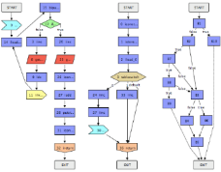
Introduction
Different control-flow paths in a program can have varying execution times.
Is this time differences explainable considering internal of programs?
In this project, we consider the problem of helping a security analyst to identify such explanations.
User inputs
Output traces
Java-based Web-Server
Application
Observables:
Response time
Memory usage
Packet sizes
Inter-packet delays

Slide 3
Trace-set discrimination (basic idea)
Given a set of execution traces with observable execution times, we can consider two approaches to explain it:
Clustering execution time into a finite set of labels, and then applying discriminant (or classifier) to explain the differences.
Using regression models, we model the relationships between program internals (function calls) and target feature (time).

Slide 4
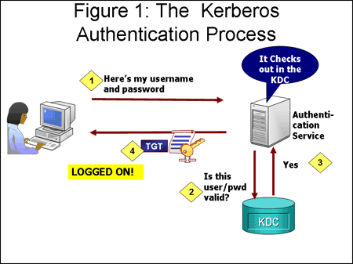

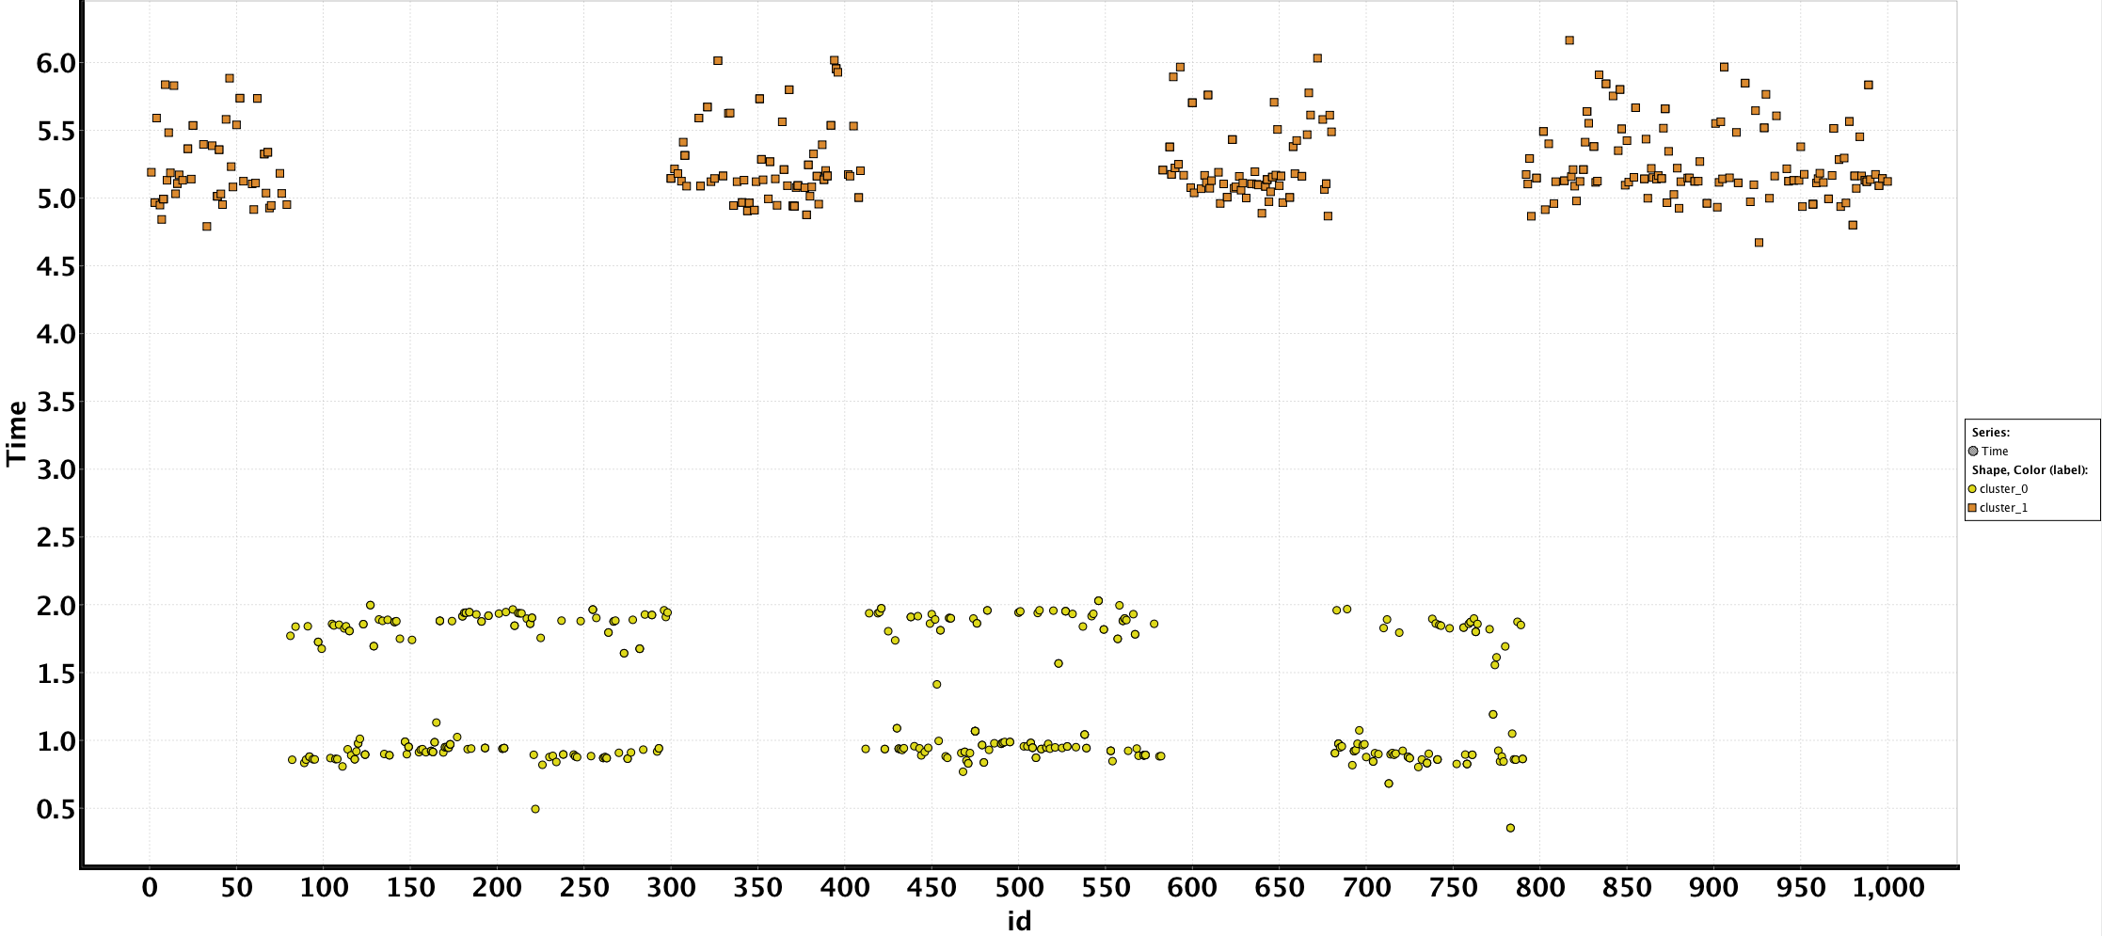
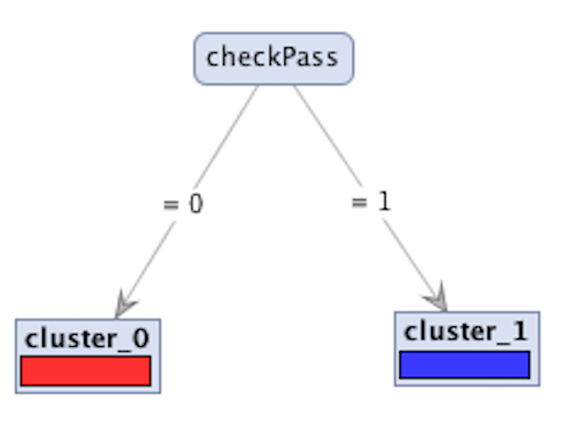
Motivation Example (1)

Slide 5
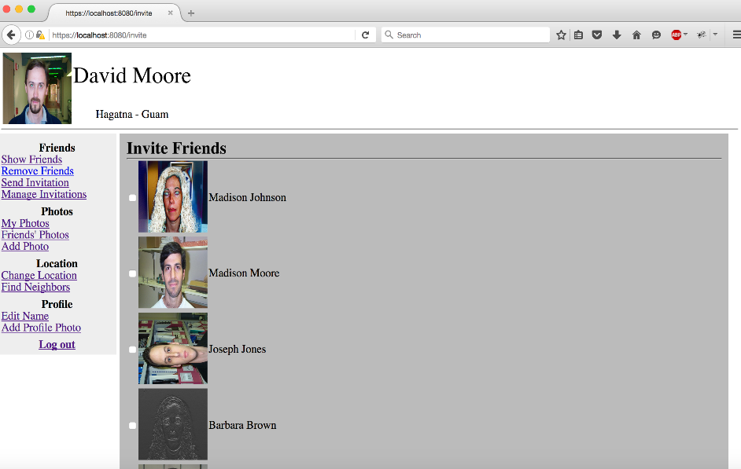
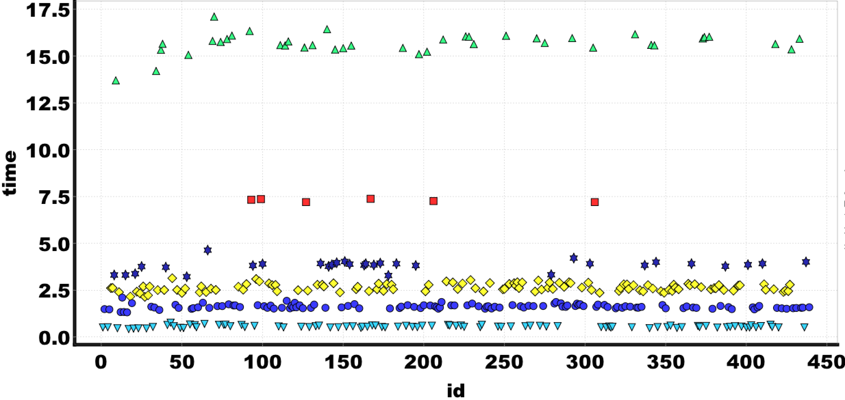
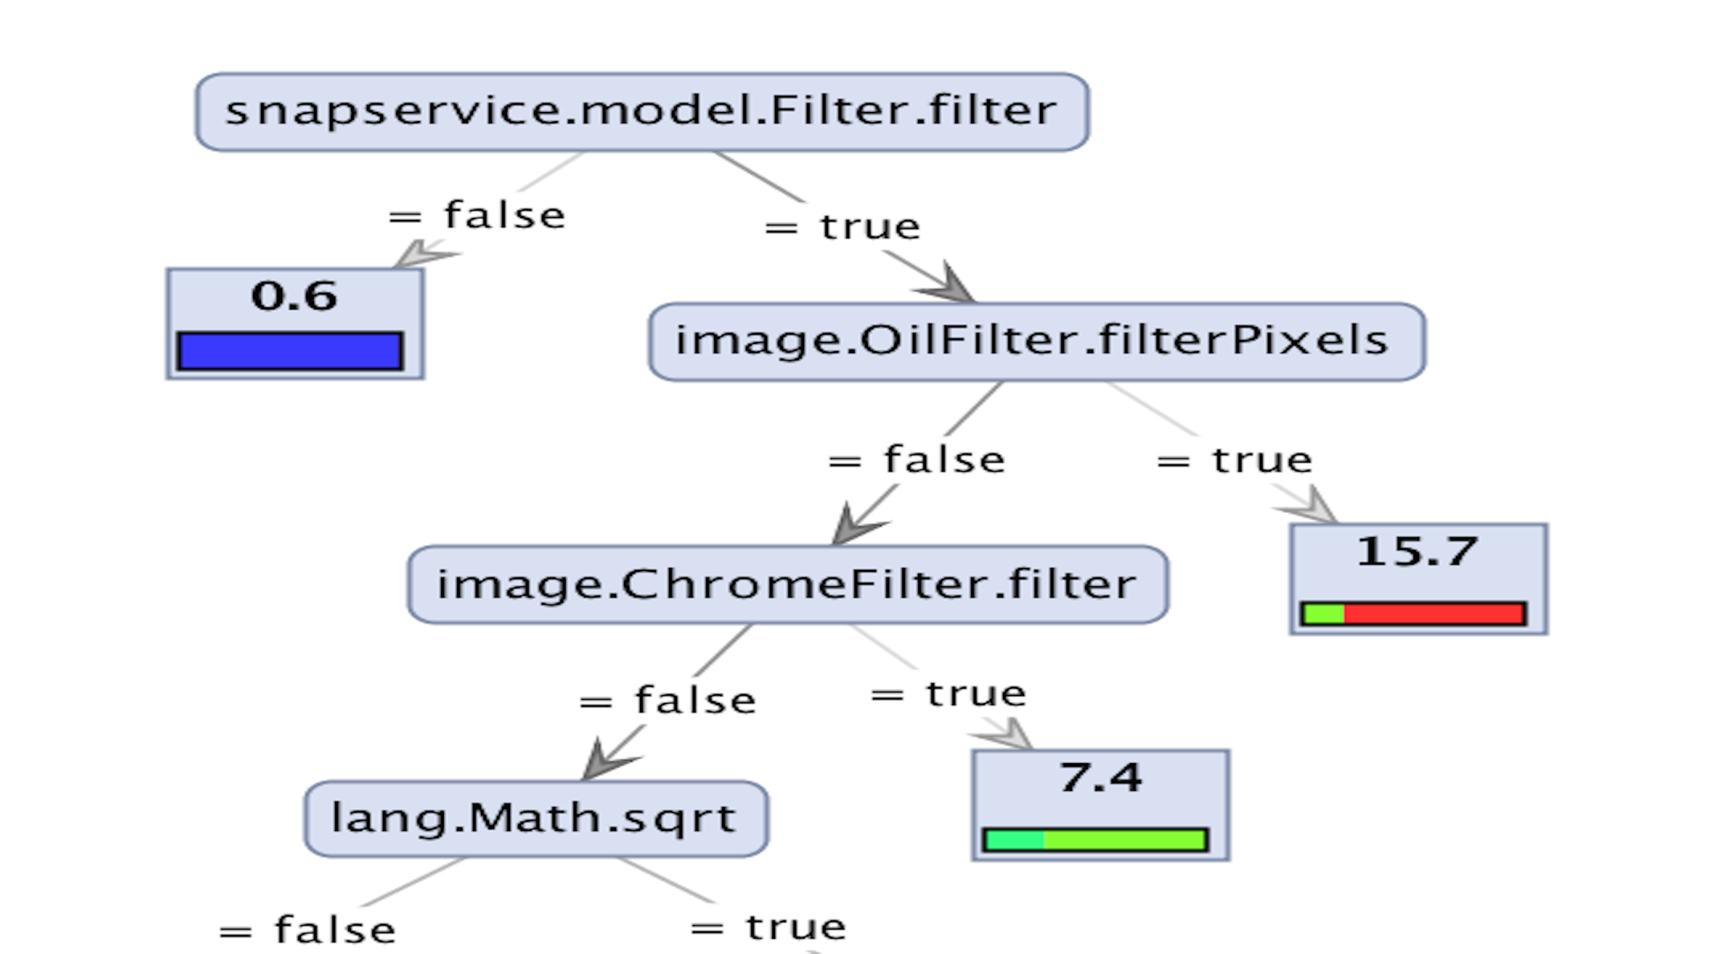
Motivation Example (2)
1. Detecting timing channel
2. Explain the timing differences with function calls

Slide 6
Methodology - Decision Tree Discriminant (1)
Attributes: Called Method.
For this case study, we are interested in seeing whether the key methods that explain the differences in execution time can be pinpointed.
Class Label: Total Execution Time Ranges.
To identify the most salient attributes, we fix a small number of possible labels, and cluster traces according to total execution time.
Weighted Labeling of Traces
Given a set of time ranges, we define a weighted labeling of traces that permits a trace to be assigned to different clusters with different weights.
Decision Tree Learning
From a training set with this weighted labeling, we apply the weighted decision tree learning algorithm

Slide 7
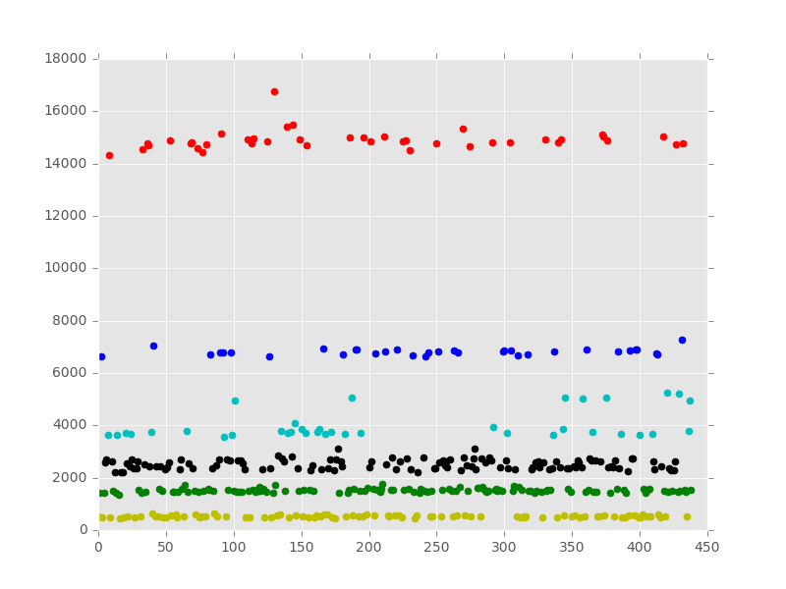
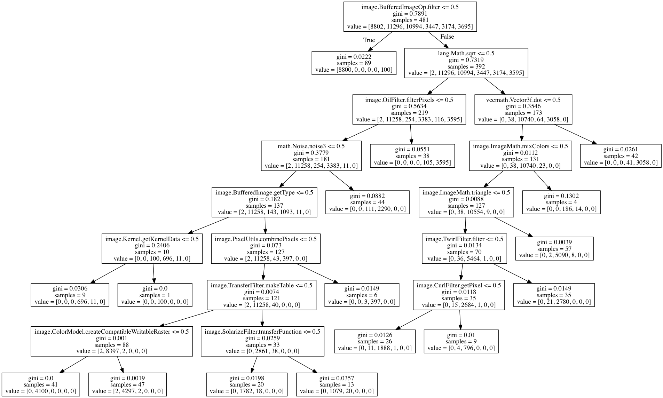
Methodology - Decision Tree Discriminant (2)
(2) Estimation of record weights
1. Clustering
(2) Estimation of record weights
(3) Labeled and weighted data set
(4) Learning decision
Tree

Slide 8
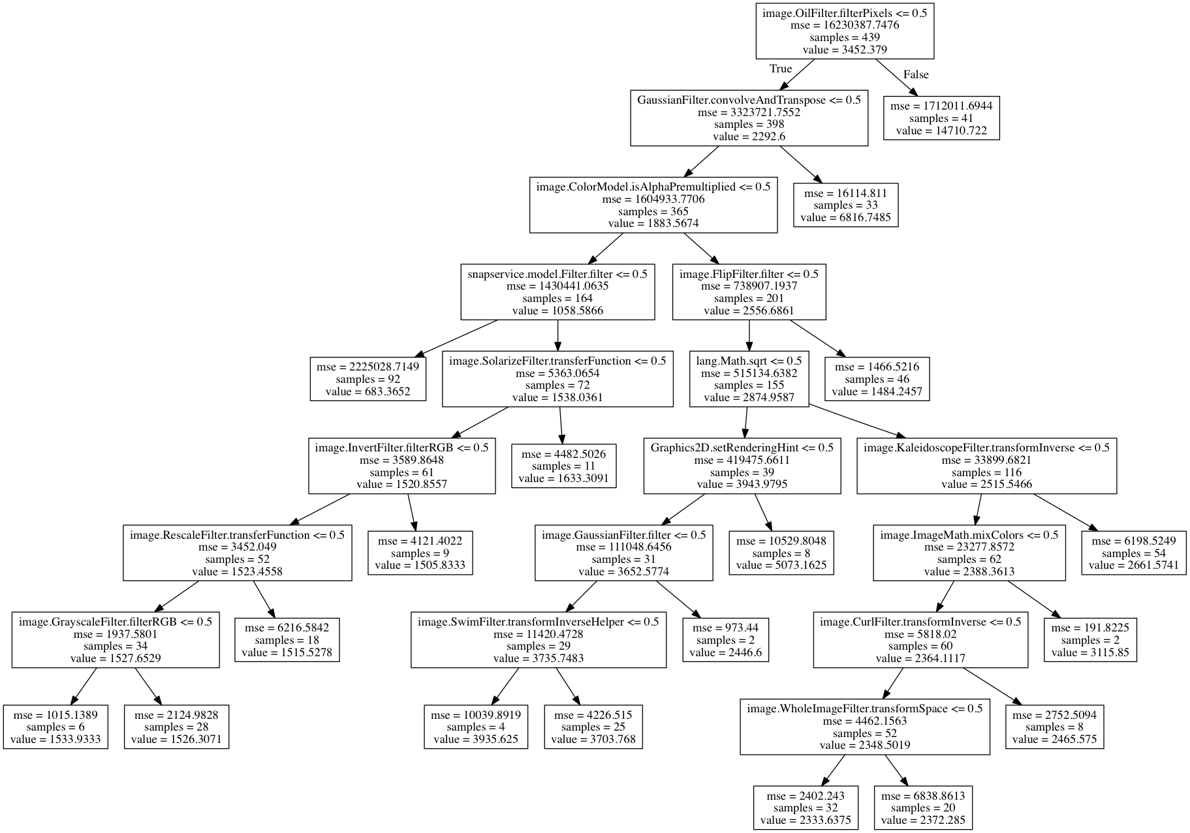
Regression Tree
Could we explain the time difference without clustering the traces in time domain?
(a) Regression Tree
(b) Decision Tree Classifier

Slide 9
How to find number of clusters in k-means
 | MSB1_10_100 | RegEx_20_10_1_101 | RegEx_150_10_2_10011 | RegEx_200_10_2_101011
Estimated number of clusters | 9 | 6 | 51 | 69
Homogeneity | 0.499 | 0.333 | 0.496 | 0.489
Completeness | 1.000 | 1.000 | 1.000 | 1.000
V-measure | 0.666 | 0.500 | 0.663 | 0.656
Adjusted Rand Index | 0.187 | 0.003 | 0.001 | 0.000
Silhouette Coefficient | 1.000 | 0.616 | 0.791 | 0.718

Slide 10
Results
Application Name | Accuracy | Height of Tree | Computation Time (s)
SnapBuddy | 99.6% | 8 | 0.01
Existing User Enumeration | 100% | 2 | 0.01
MSB1_10_100 | 100% | 7 | 0.01
RegEx_20_10_1_101 | 100% | 13 | 0.01
RegEx_150_10_2_10011 | 89.2% | 44 | 0.5
RegEx_200_10_2_101011 | 92.1% | 50 | 0.8

Slide 11
Summarize
What you did?
We apply our main intuition based on clustering and classification to learn discriminant features on two mock applications.
Since decision tree is an explanatory model, we consider it as the basis of our project, while we also try other regression and classifiers.
We develop micro-benchmark like MSB and REG to find the best way to estimate cluster numbers and apply other regression and classifier.
Who did what?
What challenges you had?
Review how well you did?
Discuss some possible extensions on how you could do better?

